Slide 1
Assignment III Network Theorems

Slide 2
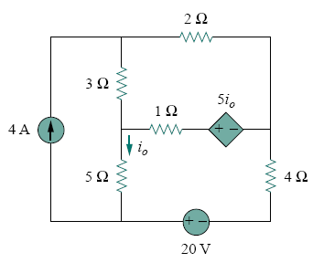
Problem 1
Determine I0 using superposition
(-0.4706 A)

Slide 3
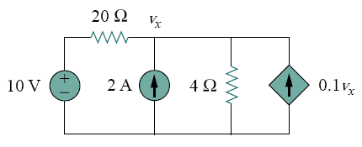
Problem 2
Determine vx using superposition
(12.5 V)

Slide 4
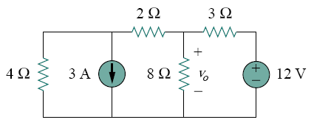
Problem 3
Determine v0 using source transformation
(3.2 V)

Slide 5
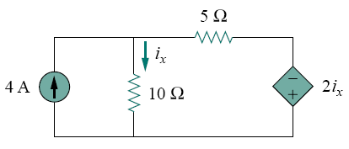
Problem 4
Determine Ix using source transformation
(1.176 A)

Slide 6
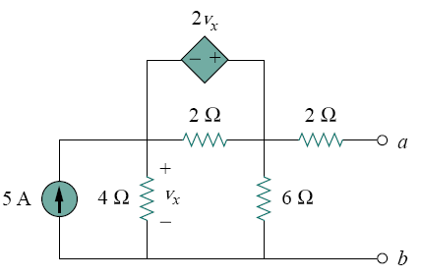
Problem 5
Determine the Thevenin equivalent at terminals a-b
(RTh=6Ω, VTh=20 V)

Slide 7
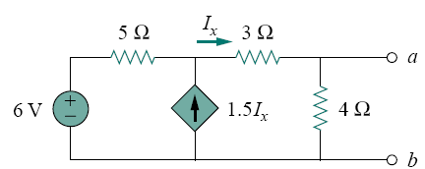
Problem 6
Determine the Thevenin equivalent at terminals a-b
(RTh=0.44Ω, VTh=5.33 V)

Slide 8
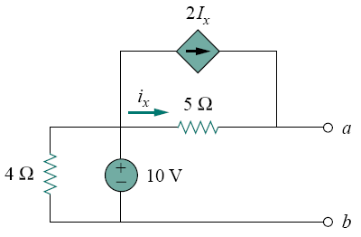
Problem 7
Determine the Norton equivalent at terminals a-b
(RN=5Ω, IN=7 A)

Slide 9
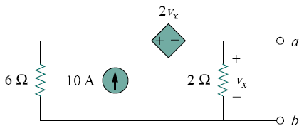
Problem 8
Determine the Norton equivalent at terminals a-b
(RN=1Ω, IN=10 A)

Slide 10
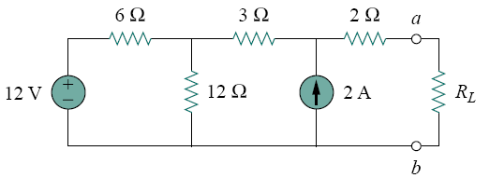
Problem 9
Determine
a) The value or RL for maximum power transfer
b) The maximum power transfer
(RL=9Ω, pmax=13.44 W)

Slide 11
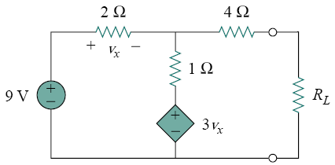
Problem 10
Determine
a) The value or RL for maximum power transfer
b) The maximum power transfer
(RL=4.22Ω, pmax=2.901 W)

